Slide 1







Slide 2


Waiting Time?

Slide 3

Menu ?

Slide 4


Slide 5

CASH ONLY

Slide 6

CASH ONLY
ONLY CARD

Slide 7
SKIP
THE
LINES
Presented by TeamHortons

Slide 8

Skip The Lines
Steps
UofT FOOD TRUCK APP
follow
Features
Factors
Intro
PRESENTED BY TEAM HORTONS
FOODIES’ CHOICE, FOOD TRUCKS’ LOVE

Slide 9



PROBLEM SPACE
70%
Purchase Experience
Promote purchase Experience
High Frequency
Of Visiting Food Truck
Food
Food Truck Management
follow
Parts
Vendor
Features
Intro
Factors
Enhance Food Truck Management
On Campus
Target Audience
UofT Food Truck Life
Explore concerns &
experiences
of food trucks
Student Daily Life
Students
Related to student daily Life
Target Audience

Slide 10



P A R T S
Part
Part
Part
1
2
3
RESEARCH
DESIGN
FEATURES
Steps
follow
Features
about
Factors
Through Survey, Questionnaire,
interview
Prototype design
Solution based on
User demand

Slide 11
P A R T S
Part
1
RESEARCH
Steps
follow
Features
about
Factors
Through Survey, Questionnaire,
interview

Slide 12
SUB PROBLEM SPACES
Steps
follow
Factors
Features
Problem Space
Food Selection
Logistic
Nutrition &
Food Safety

Slide 13

RESEARCH INSTRUMENT
Survey & Questionnaire & Observational Study
Individual
semi-structured interview
Steps
follow
Factors
Features
about
Customer
Vendors
50+ customers on Campus
5 vendors
Location & Time
Food Quality & Speed
Main factors for choosing food truck
Factors that vendors value the most

Slide 14
SAMPLE DATA
70%
67%
83%
76%
Visited Food Truck
Long Waiting Time
Lacking Nutrition Detail
Unclear Food Truck Info
Sample subjects has high frequency of visiting food truck
Over 67% of the sample are unclear of food truck info
Top one complaints
among sample
High dissatisfaction towards a lack of nutrition detail

Slide 15




USER DEMAND
NEED
NEED
NEED
NEED
NEED
1
2
3
4
5
history
timeline
about
Shorter
Waiting Time
Display
Nutrition Info
More Payment Methods
Display of Food Truck Info
Order Management assistance

Slide 16
P A R T S
Part
Part
Part
1
2
3
RESEARCH
DESIGN
FEATURE
Pats
follow
Features
about
Factors
Through Survey, Questionnaire,
interview
Prototype design
Solution based on
User demand

Slide 17
P A R T S
Part
2
DESIGN
follow
Parts
Features
about
Factors
Prototype design

Slide 18
ITERATIVE DESIGN
Finding Customer Needs through Research Instrument
Usability Testing
Low-fi Prototype Design
Getting feedbacks from user
Individual + Combined
Internal Evaluation
Investigate
customer needs
Individual Research
Plans for Low–fi & Experience Map
6
4
Heuristic evaluation
& Cognitive Walkthrough
2
Gain background info towards problem space
Identify scenario and user personas
5
1
3

Slide 19
ITERATIVE DESIGN
Final Update on Hi-Fi Prototype
Update & Design Hi-Fi Prototype
Getting feedbacks from users and evaluate through heuristic
Usability Testing with Expert & Real user
Add some brief about the heading
Final Project
7
Getting objective feedback from expert and users subjectively.
9
10
8

Slide 20
P A R T S
Part
Part
Part
1
2
3
RESEARCH
DESIGN
FEATURE
Pats
follow
Features
about
Factors
Through Survey, Questionnaire,
interview
Prototype design
Solution based on
User demand

Slide 21
P A R T S
Part
3
follow
FEATURE
Pats
Features
about
Factors
Solution based on
User demand

Slide 22


MAIN FEATURES
According to our customer demand, we introduced 2 distinguished main features in the app
Vendors
Order Voice Control
Editing Menu
Vendor can use voice control to complete the order without touching the screen
Vendors share the same menu as customer, which is good for visualization.

Slide 23
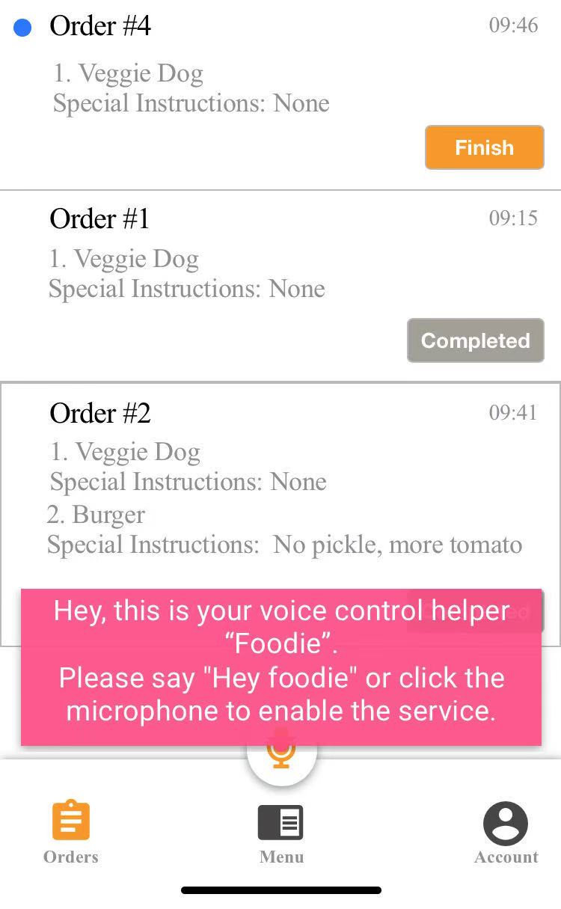
MAIN FEATURES
According to our customer demand, we introduced 3 distinguished main features in the app
NEED
5
Vendors can complete Order without touching the screen.
Assist on serving order
at rush hours.
Order Management assistance
Order Voice Control
Vendor can use voice control to complete the order without touching the screen

Slide 24
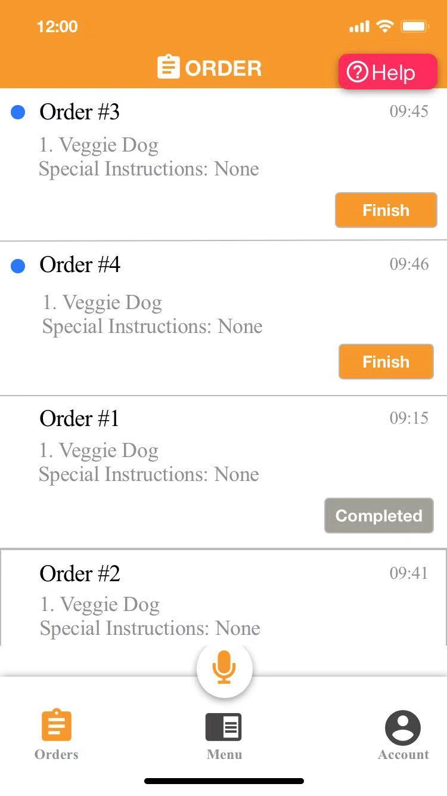
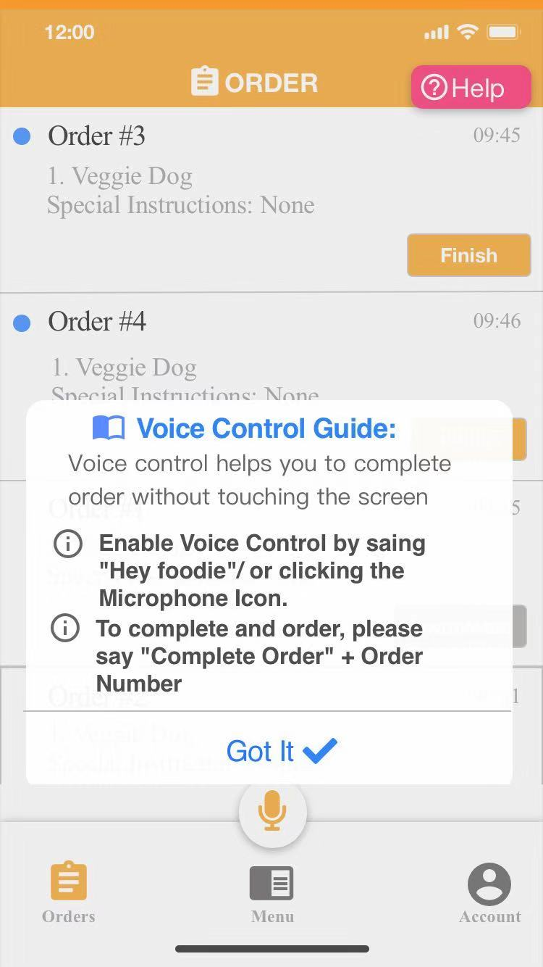
VOICE CONTROL
Order Voice Control Guide
Vendor can use voice control to complete the order without touching the screen
Based On Heuristic Evaluation
Address error prevention
Help button is easy to find
Provide thorough guide on voice control

Slide 25
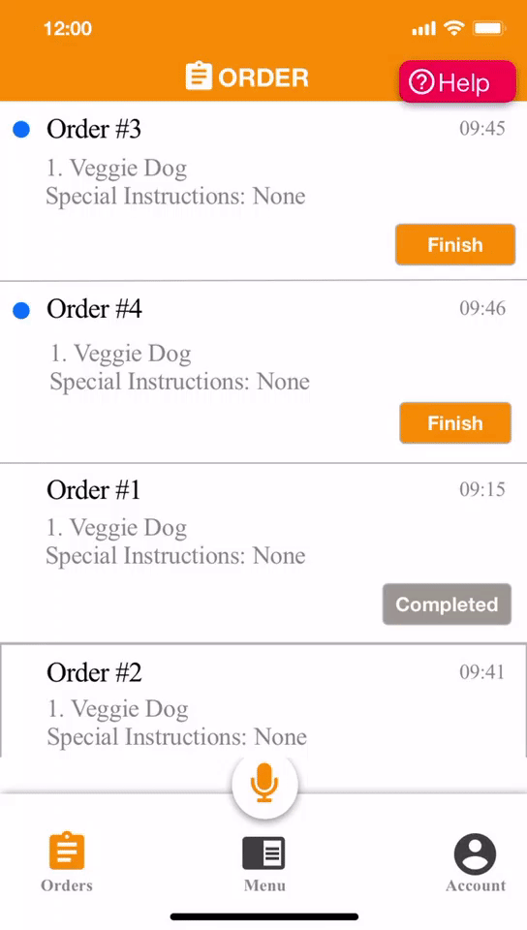
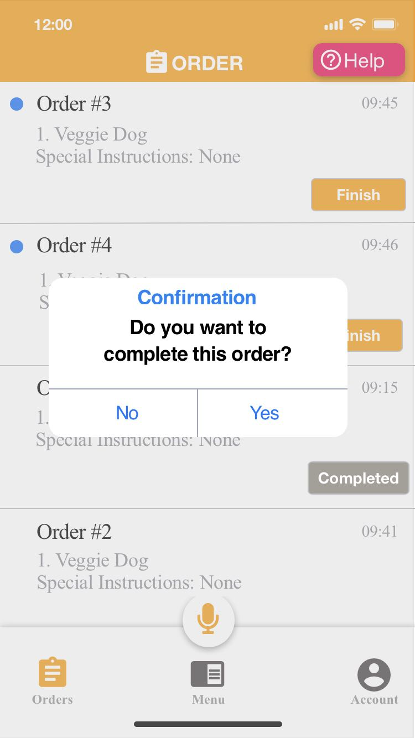
VOICE CONTROL
Order Voice Control
Vendor can use voice control to complete the order without touching the screen
Error Prevention
Based on heuristic Evaluation and expert’s advice
Vendors will receive a confirmation every time it wants to complete an order

Slide 26
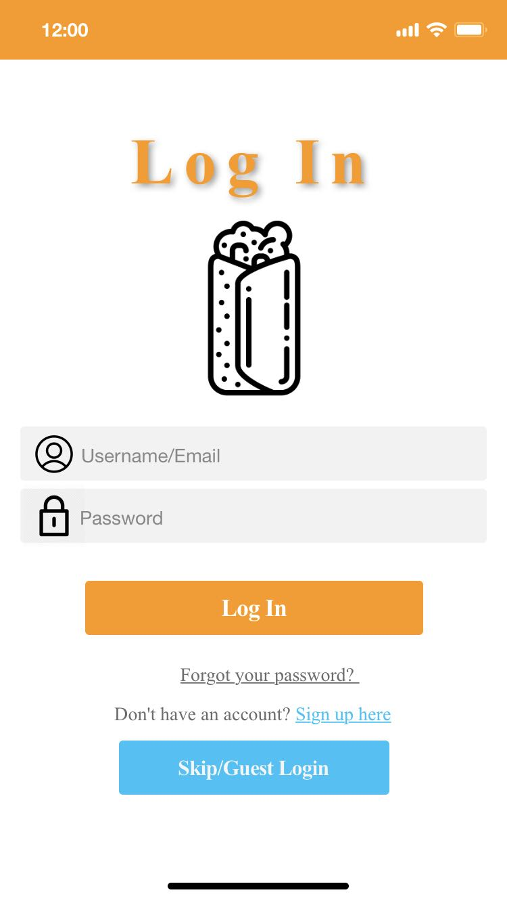
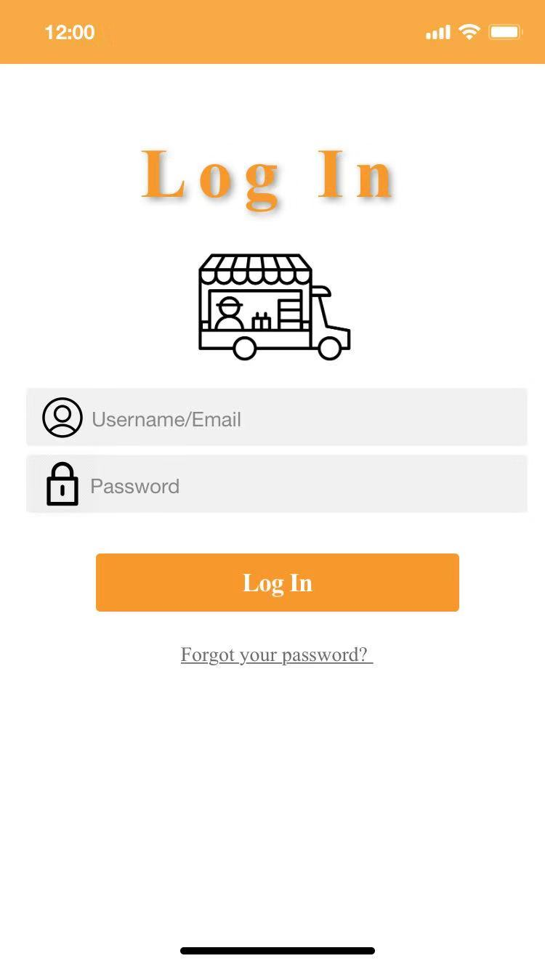
P R O T O T Y P E
Editing Menu
Separate System
Customer
Vendors

Slide 27
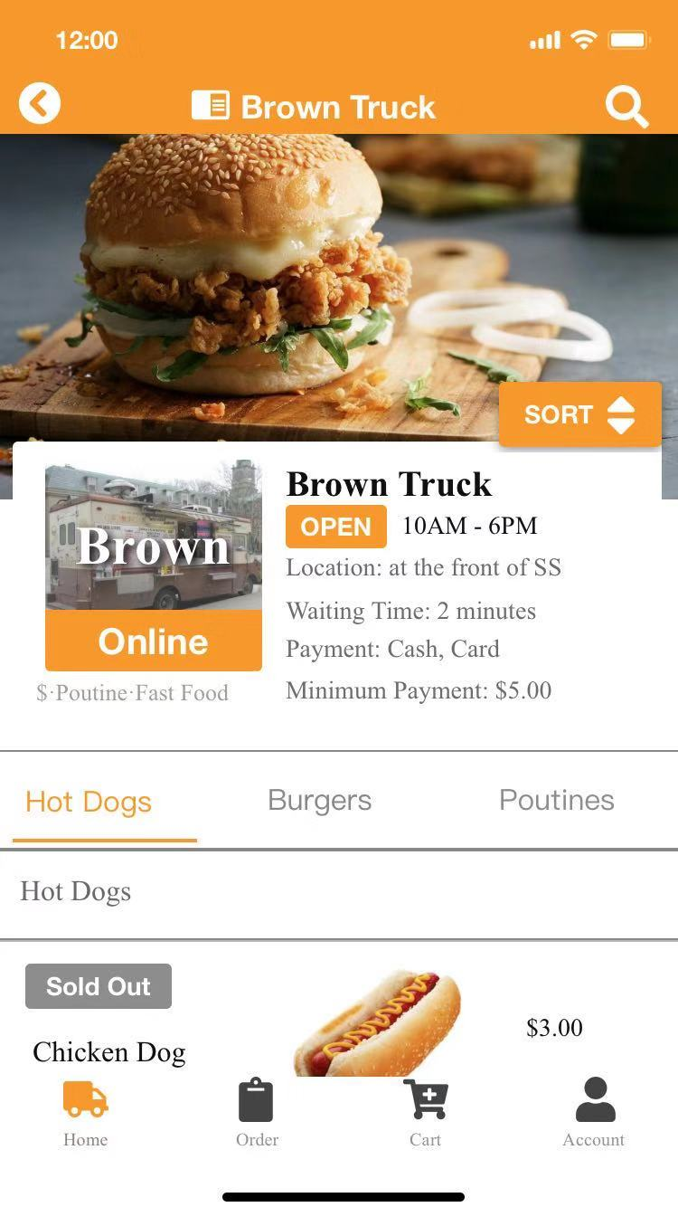
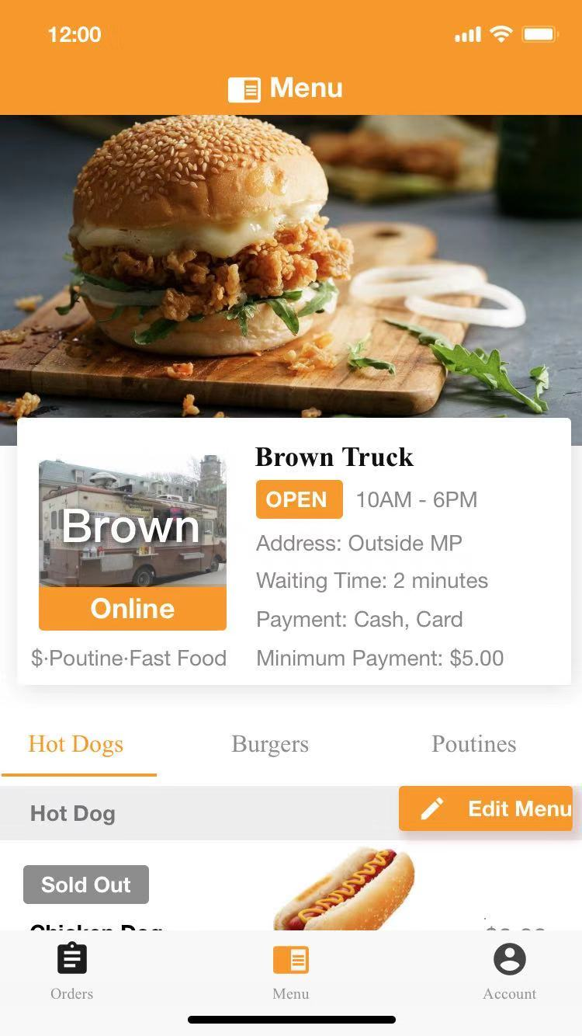
P R O T O T Y P E
Editing Menu
Same Menu
Customer
Vendors

Slide 28
P R O T O T Y P E
Editing Menu
Same Menu
PROS
Vendors share the same view of the menu with customers.
Good for visualization.
Customer
Vendors

Slide 29
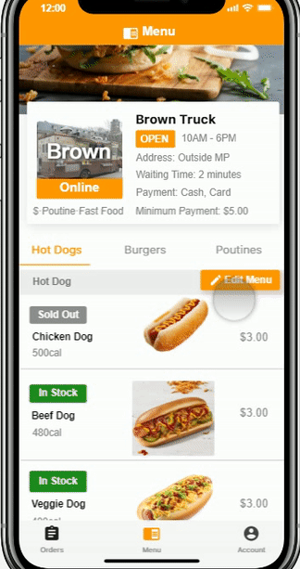
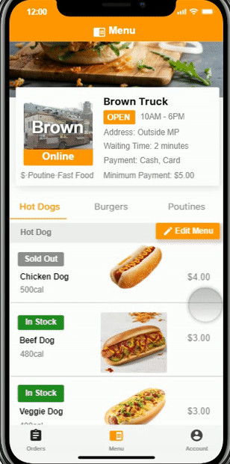
P R O T O T Y P E
Editing Menu
Same Menu
User Freedom
Based on usability testing,
Edit button is placed at a clearer position.
To suit for user convention , clicking the picture to enable edit is possible
Vendors

Slide 30
P R O T O T Y P E
Customer
Customer

Slide 31
P R O T O T Y P E
SIGN UP FREE
PROS
Customer can log in to the app without registration
Save their time & keep privacy
Customer

Slide 32




MAIN FEATURES
According to our user demand, we introduced 4 distinguished main features in the customer system
Customer
Estimated Waiting Time
Food Truck Map
Nutrition Info
Online Ordering
The app estimates waiting time for each food truck to help the user to save time
Customer can check their current location and food truck locations within the map
Nutrition info is displayed in the food truck detail
Customer can order from the app without lining up

Slide 33
P R O T O T Y P E
According to our user demand, the app estimates average waiting time for each food truck
Customer
Estimated Waiting Time
Location & Time
Main factors for choosing food truck
Food Truck Map

Slide 34
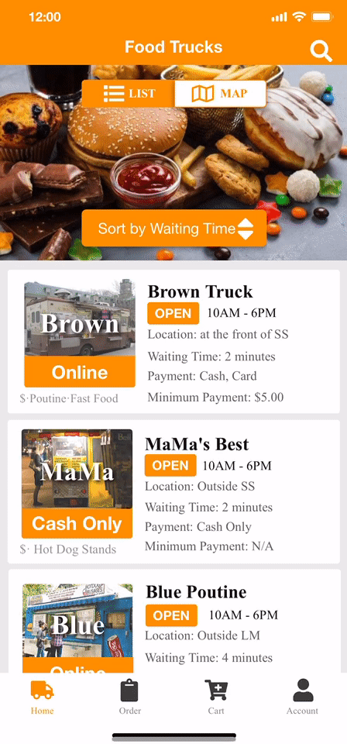
P R O T O T Y P E
According to our user demand, the app estimates average waiting time for each food truck
Estimated Waiting Time
Sort by time / Distance
Customer
In the home, page, customer can sort by waiting time / distance
Pros: Address on main factors that affect customer’s choice on food truck
Location & Time
Main factors for choosing food truck

Slide 35
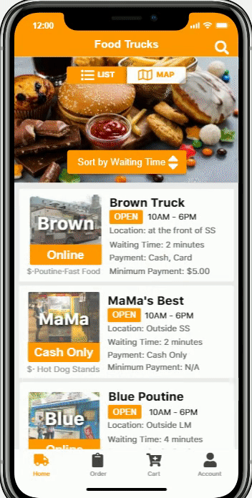
P R O T O T Y P E
According to our user demand, the app display the current location and food truck location
Food Truck Map
Customer
Check current location and food truck location
Freely switch between different food truck
Location & Time
Main factors for choosing food truck

Slide 36
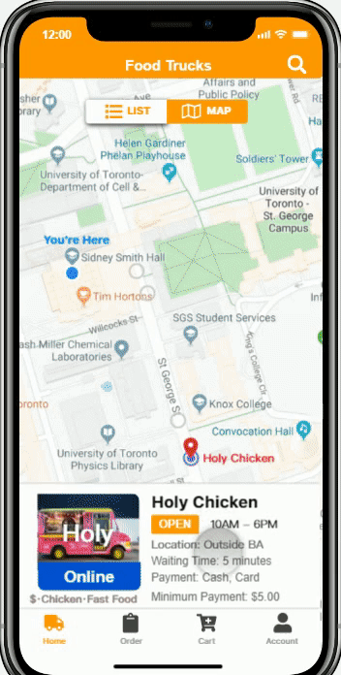
P R O T O T Y P E
According to our user demand, the app display the current location and food truck location
Food Truck Map
Customer
Check current location and food truck location
Freely switch between different food truck
Access each food truck through map view
Location & Time
Main factors for choosing food truck

Slide 37
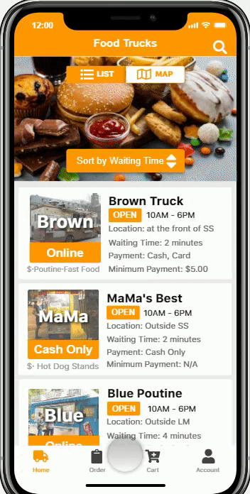
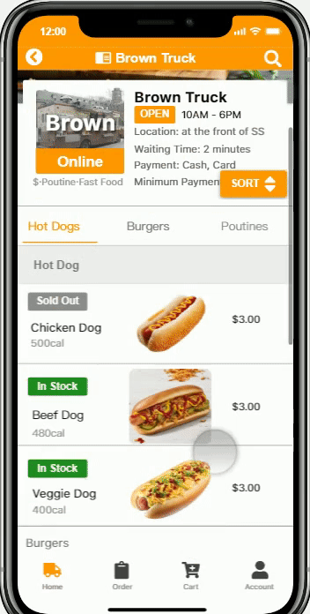
P R O T O T Y P E
According to our user demand, the app display the nutrition info and food truck info
NEED
NEED
4
2
Display of Food Truck Info
Display
Nutrition Info

Slide 38
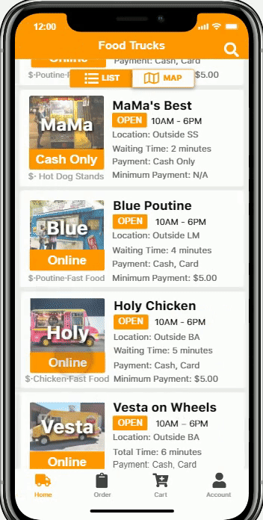
P R O T O T Y P E
Multiple Way of Accessing menu
Online Ordering
Customer can order from the app without lining up

Slide 39
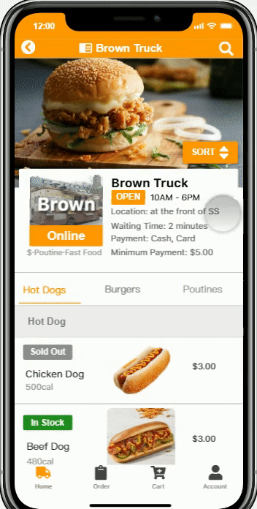
P R O T O T Y P E
Multiple Way of Accessing menu
Sort by price or
calories
Multiple Way of Accessing menu
Sort by price or
calories
Online Ordering
Customer can order from the app without lining up

Slide 40
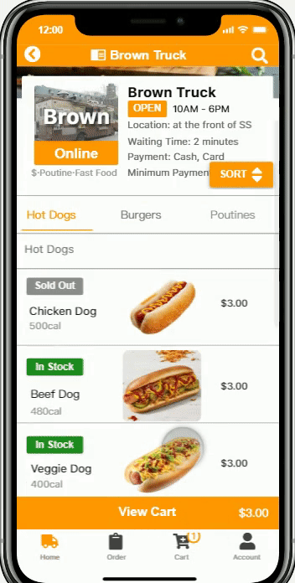
P R O T O T Y P E
Easy to add and view
Online Ordering
Customer can order from the app without lining up

Slide 41
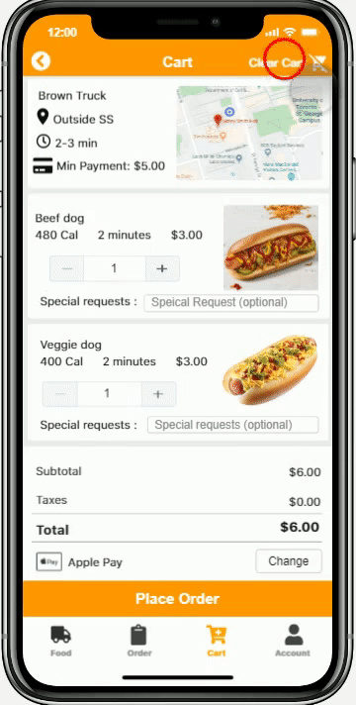
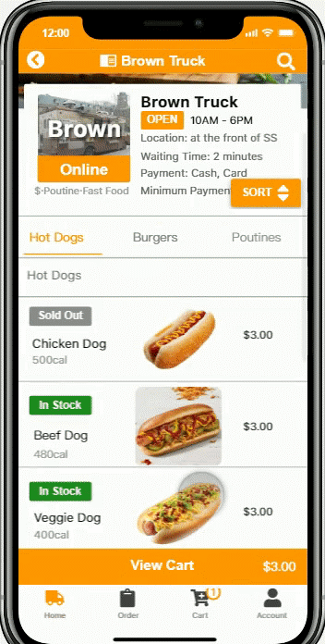
P R O T O T Y P E
Easy to add and view
Clear cart by one touch
Online Ordering
Customer can order from the app without lining up

Slide 42
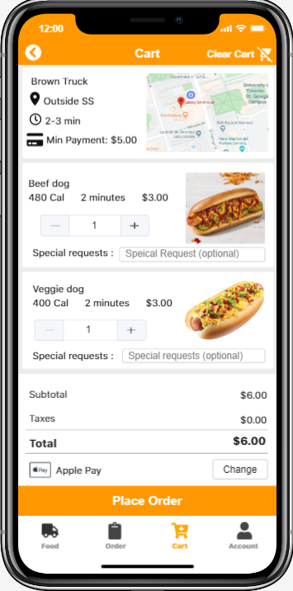
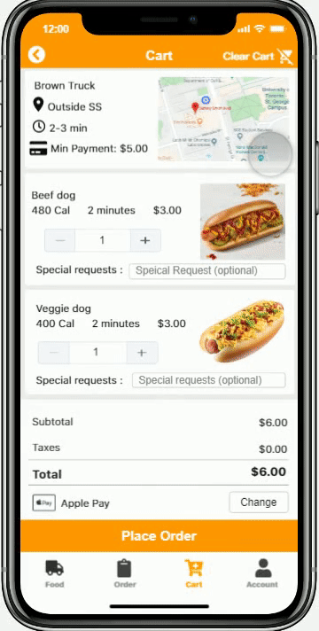
P R O T O T Y P E
Detail info of food trucks are available on Cart based on heuristic
“Match between system and the real world”
Access to map →
Check food truck location
Online Ordering
Customer can order from the app without lining up

Slide 43
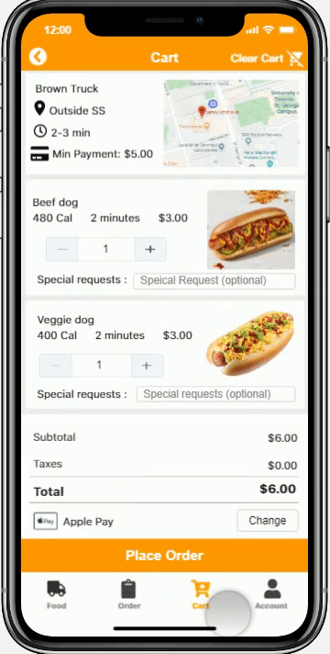
P R O T O T Y P E
Place Order just by one click
Online Ordering
Customer can order from the app without lining up

Slide 44
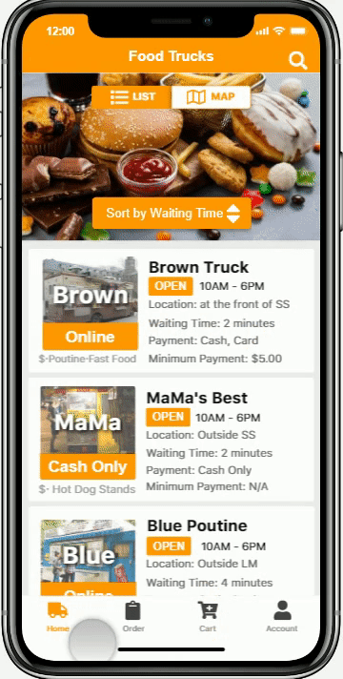
P R O T O T Y P E
Order history is easy to access through navigation bar
Online Ordering
Customer can order from the app without lining up

Slide 45
P R O T O T Y P E
Order history is easy to access through navigation bar
Online Ordering
Customer can order from the app without lining up

Slide 46
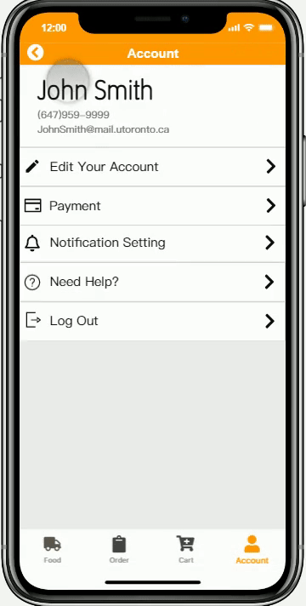

P R O T O T Y P E
Customer can freely edit their account info
Based on heuristic
“User control & Freedom”
“Match between system
and the real world”
Account Editing
Customer can edit their info on account page

Slide 47
SKIP
THE
Thank you for watching !
LINES
Presented by TeamHortons
Designed by QI ZHU

